Slide 1

FEEL THE CALM
Biodynamic Craniosacral Therapy
Your Name, RCST®
© 2021 Biodynamic Craniosacral Therapy Association of North America

Slide 2

Biodynamic Craniosacral Therapy (BCST)
My Story
Clients Who Benefit
History of BCST
How BCST Works
The Value of BCST
Biodynamic Perception
How to Learn More
Discussion Topics
© 2021 Biodynamic Craniosacral Therapy Association of North America

Slide 3
My Story
My
Background
Why I Love Practicing BCST
What Led Me to BCST
© 2021 Biodynamic Craniosacral Therapy Association of North America

Slide 4
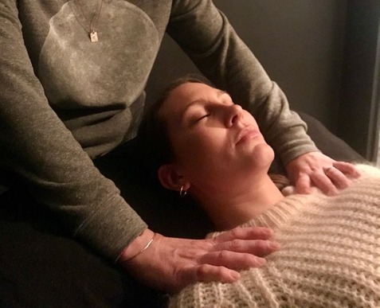
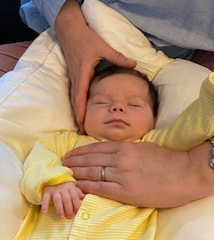
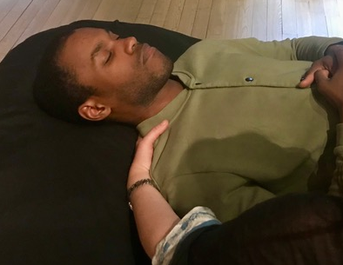
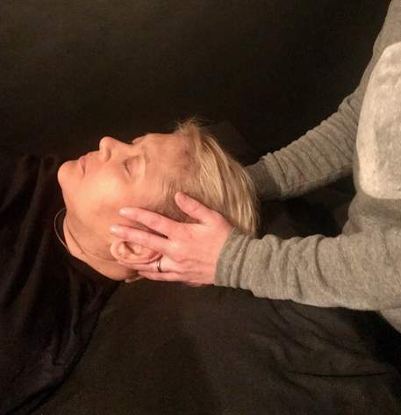
Examples of Clients Who Benefit
Because it is gentle and safe, BCST can be effective for people of all ages.
© 2021 Biodynamic Craniosacral Therapy Association of North America

Slide 5
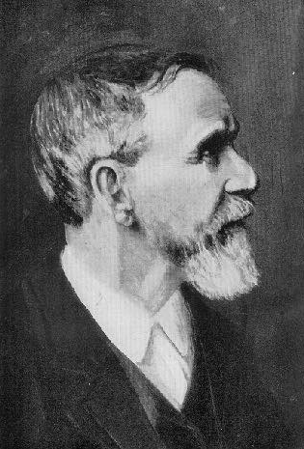
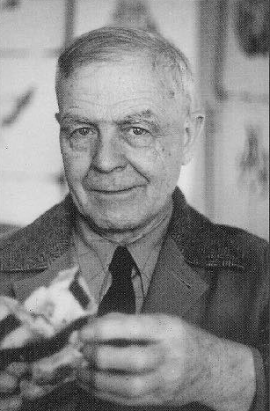
History of BCST
Andrew Still, MD, DO
1828 – 1917
Father of Osteoopathic Medicine
William Garner Sutherland, DO
1873 - 1954
© 2021 Biodynamic Craniosacral Therapy Association of North America
Notes:
Craniosacral therapy has descended from osteopathic medicine and medical doctors. Dr. Andrew Taylor Still was a surgeon during the Civil War. He noticed that the orthodox medical practices of his day were frequently ineffective and sometimes harmful. Dr. Still devoted the next thirty years of his life to studying the human body and finding alternative ways to treat disease. He was one of the first physicians of his day to promote the idea of preventive medicine and the philosophy that physicians should focus on treating the disease rather than just the symptoms.
In 1874 Dr. Still founded the American School of Osteopathy. Dr. William Garner Sutherland was a senior student at ASO in 1899. Dr. Sutherland realized from observing a dismembered skull that the "bones were beveled like the gills of a fish for a primary respiration". From his studies Dr. Sutherland discovered the "five essential aspects of the primary respiratory system" the foundation for craniosacral therapy.
William Garner Sutherland, D.O. (1873–1954) was an American osteopathic physician and important figure in American osteopathic medicine. Several of his manual therapy techniques are still practiced today by practitioners of osteopathic medicine. Sutherland was the first osteopathic physician to conceptualize the cranial approach and teach it systematically. However, Sutherland acknowledged Andrew Taylor Still as the developer of all osteopathy, including the cranial approach. Sutherland was the first person to claim to feel a rhythmic shape change in the bones of the cranium. He later applied this movement to all body tissues and this movement as the agent of change in dysfunctional tissues. He later named this motion the body’s “Primary Respiration.”

Slide 6
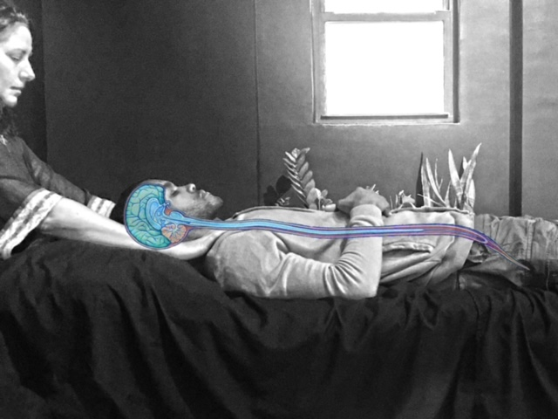
How BCST Works
The Craniosacral System
Extends from cranium (skull) down to the bottom of the sacrum (tailbone)
Governs the health of the nervous system, which influences every other system in the body
© 2021 Biodynamic Craniosacral Therapy Association of North America
Notes:
The craniosacral system extends from the cranium (or skull) down to the bottom of the sacrum (tailbone). Since it encompasses the brain and spinal cord, it governs the health of the nervous system, which influences every other system in the whole body.
As practitioners, we learn to attune and feel this movement of the craniosacral system. It takes about two years to learn and deepen one’s palpitation skills and understanding of the craniosacral therapy.
The craniosacral system is one of the first things formed in a new life, the brain and spinal column containing the nervous system. Encasing this system is a membrane: Dura mater, and bathing this system is cerebral spinal fluid, or CSF. This fluid has an inherent movement just as your heartbeat and respiration does.
The movement of the fluid is called “primary respiration” because it was formed before the lungs. The greater volume of CSF moves between your cranium/head and sacrum/tailbone and all the bones, organs and systems of the body have a relationship with this inherent movement.

Slide 7

How BCST Works
Inherent Health
BCST is based on the principle that the body is always working toward health.
It sets conditions for the body to access its own natural, inherent healing capacities.
© 2021 Biodynamic Craniosacral Therapy Association of North America

Slide 8
How BCST Works
A Biodynamic Approach
Biodynamic
Biomechanical
Taking in the whole field of the body and helping the the body’s natural healing ability to emerge
Using a protocol
applying pressure or manipulation to address a body condition
© 2021 Biodynamic Craniosacral Therapy Association of North America

Slide 9

A Holistic View
BCST helps bring forward your body’s expression of wholeness and wellness.
It helps the body remember, reorient to, and renew the health that is never lost.
© 2021 Biodynamic Craniosacral Therapy Association of North America

Slide 10

The Value of BCST
The strength of BCST lies in its ability to access your natural vitality, which helps to restore health in all dimensions of your overall well-being.
© 2021 Biodynamic Craniosacral Therapy Association of North America

Slide 11

Placeholder photo
Biodynamic Perception Exercise
© 2021 Biodynamic Craniosacral Therapy Association of North America

Slide 12

How To
Learn More
Biodynamic Craniosacral Therapy Association of North America (BCTA/NA)
www.craniosacraltherapy.org
Free articles, videos, settling meditations
BCST class information
Practitioner directory
<Add your own website and contact info here>
© 2021 Biodynamic Craniosacral Therapy Association of North America

